Slide 1
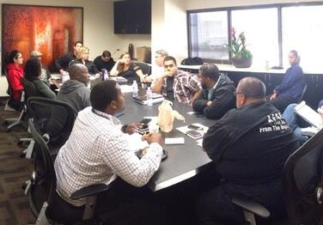
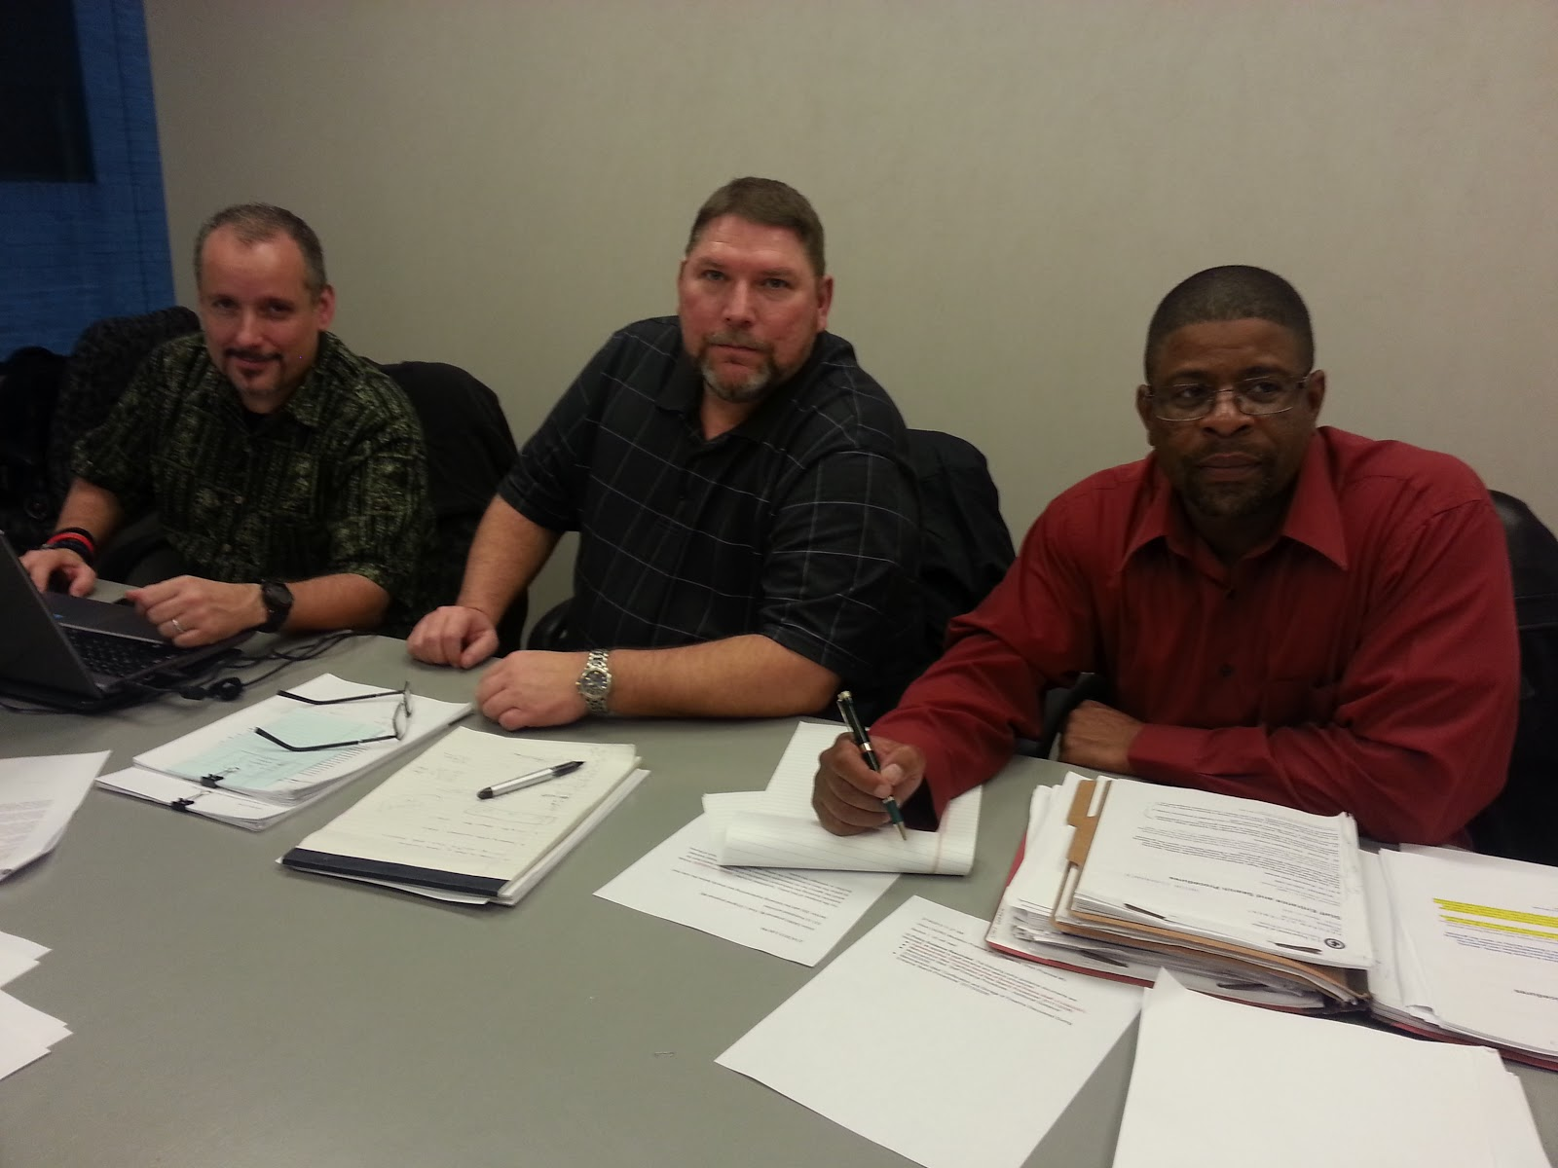
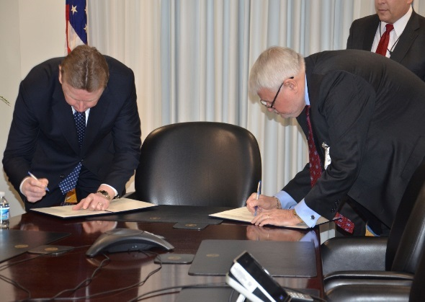
Module 3: Techniques, Tactics & Strategies
AMERICAN FEDERATION OF GOVERNMENT EMPLOYEES, AFL-CIO

Slide 2
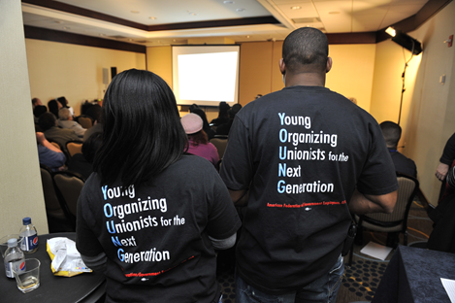
Techniques, Tactics & Strategies Stasis Theory

Slide 3
Stasis Theory: History and Background
Developed in Ancient Greece and Rome
Four core elements:
Facts: what happened
Definition: meaning or nature of the issue
Quality: seriousness of the issue
Policy: plan of action
Where exactly do we disagree?
Goal is to avoid people talking past one another

Slide 4
Stasis Theory: Facts
Did something happen?
What are the facts?
Is there a problem/issue?
How did it begin/what are its causes?
What changed to create the problem/issue?
Can it be changed?
Where did we obtain our data, are the sources reliable?
How do we know the sources are reliable?

Slide 5
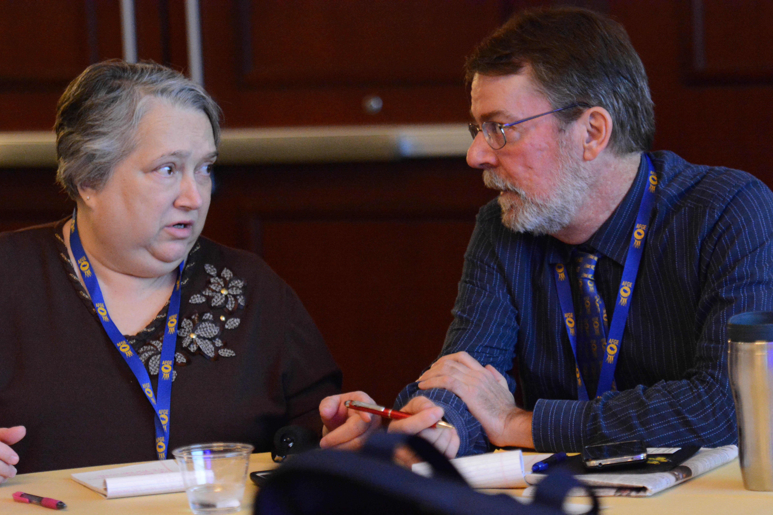
Stasis Theory: Definition
What is the nature of the problem/issue?
What exactly is the problem/issue?
What kind of problem/issue is it?
Is it part of a broader class of things or events?
What are its parts and how are they related?
Who/what is influencing our definition of the problem/issue?

Slide 6
Stasis Theory: Quality
Is the issue a good thing or a bad thing?
How serious is the problem/issue?
Whom might it affect (stakeholders)?
What happens if we do nothing?
What are the costs of solving the problem/issue?
Who or what is influencing our determination on how serious the issue is?

Slide 7
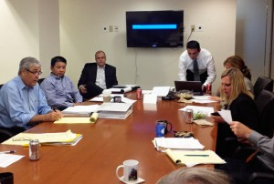
Stasis Theory: Policy
Should action be taken?
Who should be involved in helping solve the problem/address the issue?
What should be done about the problem?
What needs to happen to solve this problem/address this issue?
Who/what is influencing our determination of what to do about this problem/issue?
How/why are these sources influencing our decision?

Slide 8
Stasis Theory: Example
Tina’s grievance:
Fact: Tina has been late three times this week. Union and Agency agree – stasis.
Definition: Late arrival is a violation of the personnel policy. Union and Agency agree – stasis.

Slide 9
Stasis Theory: Example
Tina’s grievance:
Quality: Tina has made up the time she arrived late by staying after hours. Union – the issue is less serious than someone who is late without making up the time. Agency – late arrival is a serious issue and making up the time is not allowed. = Core area of disagreement.
Policy: What discipline will Tina be given? Union and Agency agree that the policy book states that discipline for tardiness should be reasonable based on the seriousness of the offense = stasis.

Slide 10
STASIS THEORY & NEGOTIATIONS
How could the bargaining process be improved by applying stasis theory?

